Slide 1
Formal Language and Automata Theory

Slide 2
The Story So Far
Violates Pumping Lemma
For CFLs
0^{n}1^{n}
0^{n}1^{n}2^{n}
Violates Pumping Lemma For RLs
0^{n}
Described by DFA, NFA, RegExp, RegGram
w
Described by CFG, PDA
Regular Languages
Deterministic CFLs
Context-Free Languages

Slide 3
The Key Question
Is it possible to design a formal model of a computational device that capture the capabilities of any algorithm?
Alan Turing, 1940’s: Yes!

Slide 4
Turing Machine
Turing Machine is COOOOOL, why?
Understanding it makes us more like CS guys
But, probably there are few graduate students who really understand it.
Because, most of us forgot the details very soon after we learnt it. ☹
Anyway, it is cool, instinctively.

Slide 5
Turing Machine
Why it is cool, seriously
Anything a real computer can compute, a TM can also compute.
Despite its simplicity, TM can be adapted to simulate the logic of any computer that could possibly be constructed.
Therefore, TM is the foundation of computational complexity theory.
A basis to analyze algorithms

Slide 6
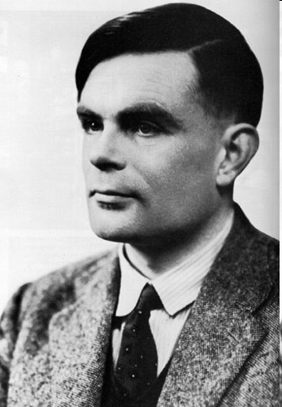
Alan Turing
1912-1954
Great mathematician
The father of
the modern computer

Slide 7
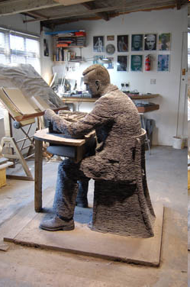
Alan Turing’s Statue
at Bletchley Park

Slide 8
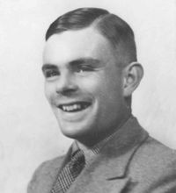
Alan Turing (June-23, 1912 – June-7, 1954) PHD, Princeton
His masterpiece is On Computable Numbers, with an Application to the Entscheidungsproblem
He achieved world-class Marathon standards.
His best time is 2 hours, 46 minutes, 3 seconds,
only 11 minutes slower than the winner in the 1948 Olympic Games.
Alan Turing is the father of computer science. The ACM Turing Award is widely considered to be the CS world’s “Nobel Prize”

Slide 9
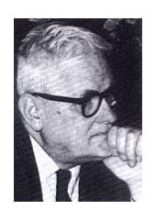
Church-Turing Thesis
Every computer algorithm can be implemented as a Turing machine
Therefore, C, C++, Prolog, Lisp, Small talk, and Java programs can be simulated in Turing machines
Definition: a programming language is Turing-complete if it is equivalent to a Turing machine.

Slide 10
Alan Turing was interested in
whether there was a way to define which problems were/were not decidable (computable)?
can we create a machine to simulate the human brain so that those computable problems can be solved automatically?
1935-36, Turing was working on a paper, “computable numbers”. The Turing machine in this paper turned out to be the simplest prototype of all computers!

Slide 11
Turing’s Idea
thinks
reads
a+b*x/y
makes notes
State of mind changes

Slide 12
Actions of a Turing Machine
depending on current state
and
current tape symbol
Change
state
Write a new symbol
onto the current tape square
Move left/right one square

Slide 13
Designing Universal Computational Devices Was Not The Only Contribution from Alan Turing…
In the year 1941:
The world is at war
Nazi Germany has succeeded in conquering most of west Europe
Britain is under siege
British supply lines are threaten by German
Germany used the Enigma Code, considered unbreakable
Alan Turing led a group of scientist that broke the enigma code

Slide 14
Turing Machine
This tape is for input, storage and output
Finite
Control
Tape head
TM is a 7-Tuple (Q, Σ, Γ, δ, q₀, B, F)
Q is a set of states
Γ is a set of tape symbols
B ∈ Γ is a blank symbol
Σ ⊆ Γ\{B} is a set of input symbols
q₀ is the start state
F ⊆ Q is a set of final states

Slide 15
Turing Machine (Cont’)
δ: the transition function
δ(q,X): a state q and a tape symbol X
δ(q,X) = (p,Y,D) where:
p is next state in Q
Y is the symbol written in the cell being scanned
D is a direction, either L or R
A transition can be described as follows
Change from state q to p, update the current symbol X with Y, and move the tape head to D (left or right)
q
X/Y, D
p

Slide 16
Turing Machine (Cont’)
Initially, the input string (finite-length string of symbols) is placed on the tape
All other tape cells, extending infinitely to left and right, hold blanks
Blank is a tape symbol, but not an input symbol
Initially, tape head points to the beginning of the input string

Slide 17
Turing Machine (Cont’)
Tape head: always positioned at one of tape cells
A move (or say ‘a step’) may:
Read an input symbol
Change machine state
Write a tape symbol in the cell scanned
Move the tape head left or right

Slide 18
Turing Machine (Cont’)
So simple, right? But…
The computational capabilities of all other known computational models (e.g. any automata) are less than or equivalent to TM
Their speeds may not be as same as that of the TM’s
Their computational capabilities are less than or equivalent to TM, i.e., no ‘more’ mathematical functions can be calculated
“Every function that can be physically computed can be computed by a Turing Machine."
This is the famous Church-Turing Thesis

Slide 19
Example 1
L = {0^{n}1^{n} | n ≥ 1}
Idea: Repeatedly change the first ‘0’ to X, then find a ‘1’ and change it to Y, until all ‘0’s and ‘1’s have been matched.
X
0
0
0
1
1
Y

Slide 20
Example 1
Start

Slide 21
Example 1(2)
Consider the input “0011”
1. Tape
#
#
0
0
1
1
#
#
#
2. Tape
#
#
X
0
1
1
#
#
#
3. Tape
#
#
X
0
Y
1
#
#
#

Slide 22
Example 1(3)
Consider the input “0011”
4. Tape
#
#
X
X
Y
1
#
#
#
5. Tape
#
#
X
X
Y
Y
#
#
#
6. Tape
#
#
X
X
Y
Y
#
#
#

Slide 23
Example 1(4)
Consider the input “0111”
1. Tape
#
#
0
1
1
1
#
#
#
2. Tape
#
#
X
1
1
1
#
#
#
3. Tape
#
#
X
Y
1
1
#
#
#
4. Tape
#
#
X
Y
1
1
#
#
#

Slide 24
Example #1: {0^{n}1^{n} | n >= 1}
0 1 X Y B
q₀ (q₁, X, R) - - (q₃, Y, R) -
q₁ (q₁, 0, R) (q₂, Y, L) - (q₁, Y, R) -
q₂ (q₂, 0, L) - (q₀, X, R) (q₂, Y, L) -
q₃ - - - (q₃, Y, R) (q₄, B, R)
q₄ - - - - -
Sample Computation: (on 0011)
q₀0011 |— Xq₁011
|— X0q₁11
|— Xq₂0Y1
|— q₂X0Y1
|— Xq₀0Y1
|— XXq₁Y1
|— XXYq₁1
|— XXq₂YY
|— Xq₂XYY
|— XXq₀YY
|— XXYq₃Y
|— XXYYq₃
|— XXYYBq₄

Slide 25
Example #2: {w | w is in {0,1}* and w ends with a 0}
Q = {q₀, q₁, q₂}
Γ = {0, 1, B}
Σ = {0, 1}
F = {q₂}
δ:
0 1 B
q₀ (q₀, 0, R) (q₀, 1, R) (q₁, B, L)
q₁ (q₂, 0, R) - -
q₂ - - -

Slide 26
Construct a TM for each of the following.
To recognize the language {0^{n}1^{n}2^{n}}

